Slide 1
Predicting Heart Disease
CPSC 5330: Big Data Analytics – Final Project
Anjali Sebastian, Nitharsan Sivakanthan, Liya LaPierre

Slide 2


Problem Statement
Heart disease is one of the highest leading causes of death in the US.
1 in every 4 deaths in the US is caused by heart disease
Accurately predicting heart disease early can help people at-risk take precautions and measures to prevent it later in life
We want to predict heart disease based on several factors of individuals

Slide 3

The Data
Data is from the CDC's 2017 and 2019 BRFSS surveys
Telephone surveys on health-related risk behaviors
Total 1 GB of data
What we are using:
Response: Whether someone has a history of heart disease or heart attack
Predictors:
Demographics – sex, age, education, income
Current status – BMI, mobility, self-rated overall, physical, and mental health
Medical history – high blood pressure, high cholesterol, diabetes, stroke
Health behaviors – smoking, heavy drinking, daily fruit and vegetable consumption, exercise
Healthcare access – insurance, can afford medical care

Slide 4
TOOLS AND Methods
Jupyter Notebook
Preparing data – read from S3 or local into PySpark
Cleaned data
Removed null values
Removed rows with "don't know" or "refused" responses
Recoded values for some variables
Split data for demo and train/test set
10% reserved for demonstration
Of 90% remaining, 30% reserved for testing the model
Addressing imbalanced classes
Trained and tested with original, oversampled, and undersampled data
Random forest classifier – PySpark Library

Slide 5
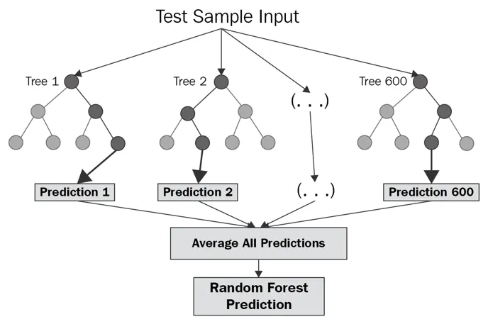
Random Forest Classifier
Ensemble approach to decision tree modeling
creates many decision trees and considers each of them to create the best decision tree
takes a sample of m of the p possible predictors to develop each tree
The algorithm searches for more possible ensembles compared to other approaches
Other ensemble methods might only consider the best predictor at each step

Slide 6
Results
Regular
Oversampled
Undersampled
Accuracy: 0.91
Recall: 0.00
Precision: n/a
F1: n/a
Accuracy: 0.74
Recall: 0.77
Precision: 0.23
F1: 0.35
Accuracy: 0.74
Recall: 0.79
Precision: 0.23
F1: 0.35
 | P-No | P-Yes
No | 127,301 | 0
Yes | 12,929 | 0
 | P-No | P-Yes
No | 94,241 | 33,060
Yes | 3,015 | 9,914
 | P-No | P-Yes
No | 92,998 | 34,303
Yes | 2,778 | 10,151
Evaluating classification models:
Accuracy: proportion of predictions that were correct, (TP + TN) / (TP + TN + FP + FN)
Recall: proportion of actual positives that were predicted as positive, TP / (TP + FN)
Precision: proportion of positive predictions that were correct, TP / (TP + FP)
F1 Score: scores model on both precision and recall
Notes:
Oversampled Train- .56 mill
Regular Train -
Undersampled Train – 63,000

Slide 7

DEMONSTRATION
https://github.com/anjumorris/BigDataProject.git

Slide 8
Lessons & Challenges
Setting up tools and environment for all team members early.
Cleaning and Processing Data takes time.
Cleaning the data between different years is a challenge.
Unbalanced Data can lead to misleading results.
Google search is your friend - PySpark has a variety of functions to perform ML on large datasets.

Slide 9
IMPROVEMENTS & FUTURE WORK
Classification Model Performance
Try other classification algorithms - e.g., neural network
Data on genetic factors or family history
Create a more interactive application for users to analyze their heart risk

Slide 10
THANK YOU
Questions ?

Slide 11
References
Centers for Disease Control and Prevention. (2018). 2017 BRFSS Data. CDC.gov. https://www.cdc.gov/brfss/annual_data/annual_2017.html.
Centers for Disease Control and Prevention. (2020). 2019 BRFSS Data. CDC.gov. https://www.cdc.gov/brfss/annual_data/annual_2019.html.
Code References:
https://www.kaggle.com/code/alexteboul/diabetes-health-indicators-dataset-notebook/notebook
https://medium.com/@junwan01/oversampling-and-undersampling-with-pyspark-5dbc25cdf253
https://github.com/spark-examples/pyspark-examples/
https://www.delftstack.com/howto/python/python-read-file-into-dictionary/

